Slide 1

ML/AI for Prediction of Physician and Laboratory Diagnostic Testing
Presented by : Anjum Banu Ismail MSc. Data Analytics | Academic Supervisor: Dr. Laura Boyle Queen’s University Belfast | Company Supervisor: Scott Morrison Diaceutics PLC

Slide 2
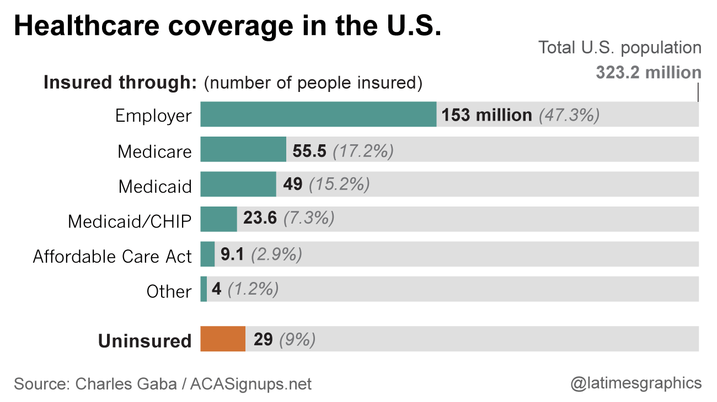
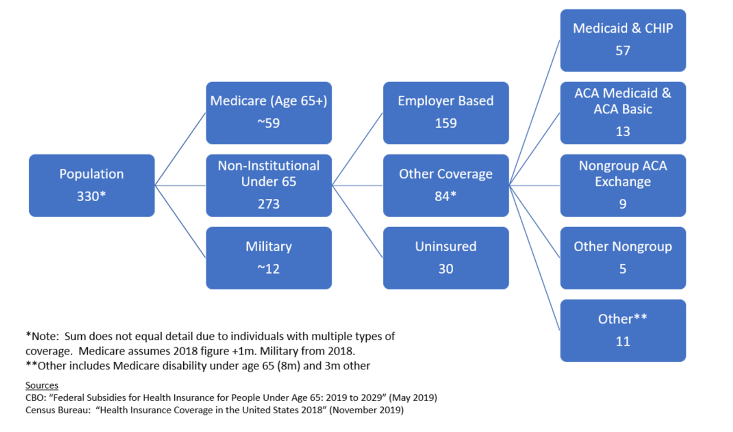
Background
Health insurance in the United States is any program that helps pay for medical expenses, whether through privately purchased insurance, social insurance, or a social welfare program funded by the government.
This usage includes both private insurance programs and social insurance programs such as Medicare
Medicare is a federally administered insurance program that Americans pay into throughout our working lives and enrol in after they retire or in case of a serious disability.
Commercial insurance is required to protect its business interests by avoiding those most likely to use medical care by providing it for people below 65.

Slide 3
Problem Statement
Year | Lab |  | Physician
 | Medicare | Commercial | Medicare | Commercial
2017 | Q1 | Q1 | Q1 | Q1
 | Q2 | Q2 | Q2 | Q2
 | Q3 | Q3 | Q3 | Q3
 | Q4 | Q4 | Q4 | Q4
2017 | Q1 | Q1 | Q1 | Q1
 | Q2 | Q2 | Q2 | Q2
 | Q3 | Q3 | Q3 | Q3
 | Q4 | Q4 | Q4 | Q4
2018 | Q1 | Q1 | Q1 | Q1
 | Q2 | Q2 | Q2 | Q2
 | Q3 | Q3 | Q3 | Q3
 | Q4 | Q4 | Q4 | Q4
2019 | Q1 | Q1 | Q1 | Q1
 | Q2 | Q2 | Q2 | Q2
 | Q3 | Q3 | Q3 | Q3
 | Q4 | Q4 | Q4 | Q4
2020 | Q1 | Q1 | Q1 | Q1
 | Q2 | Q2 | Q2 | Q2
 | Q3 | Q3 | Q3 | Q3
 | Q4 | Q4 | Q4 | Q4
2021 | Q1 | Q1 | Q1 | Q1
 | Missing | Q2 | Missing | Q2
 | Missing | Q3 | Missing | Q3
We have volumes of Malignant Lung Cancer patient reported every quarter by Physicians (Orders for testing) and Labs (Performs the testing) from year 2017 to 2021.
The Commercial data is always a lot more up-to-date than the Medicare data.
We answer the following questions through this project:
How to make consistent Patients volume predictions across the Medicare care using its past volumes and updated volumes of Commercial data for every ID?
Which time series model is the best for an aggregation level?
Which methodology is better for the forecast of our problem — and why?

Slide 4
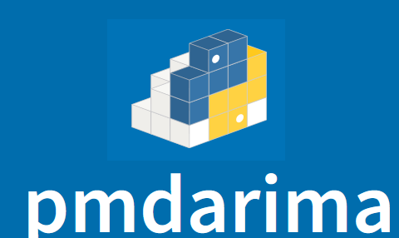














Data Science Pipeline and Tools Used
Forecasting
Deployment

Slide 5
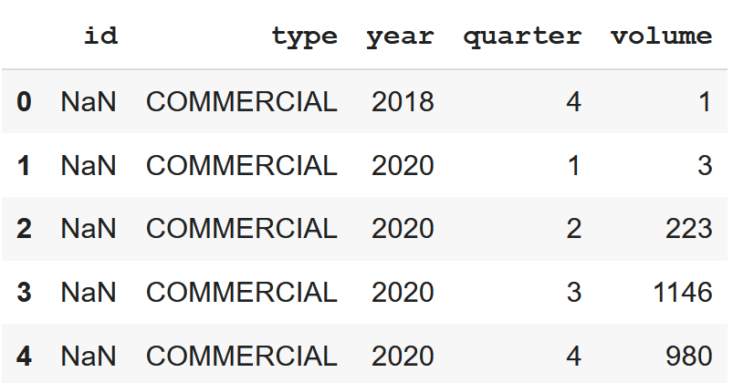
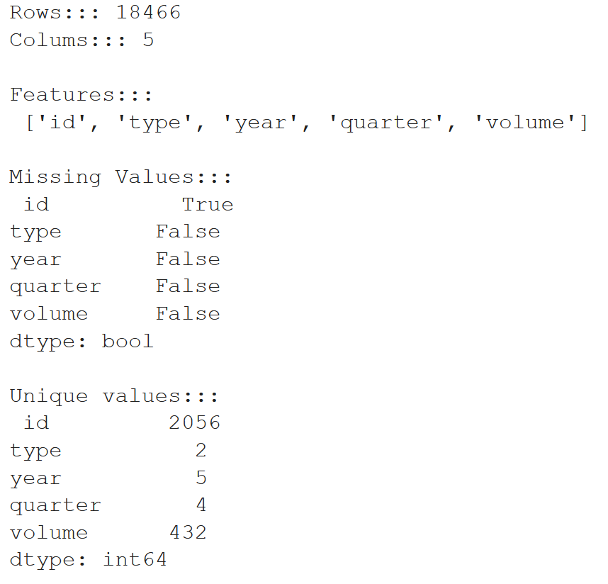
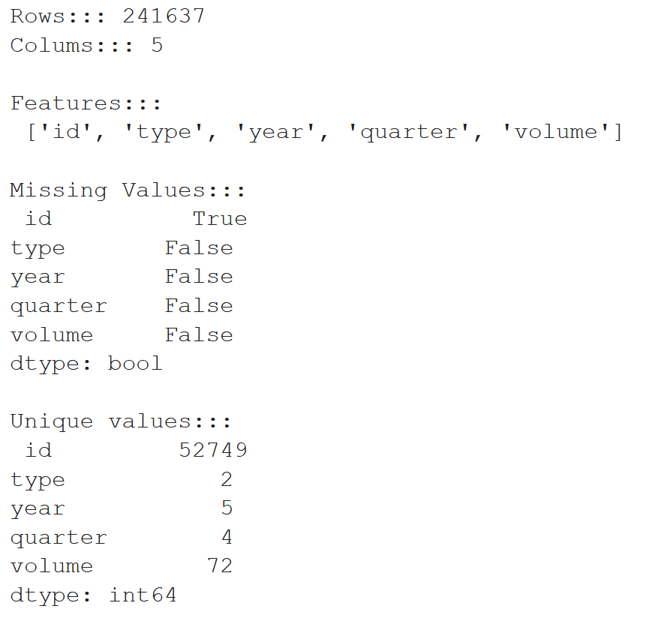
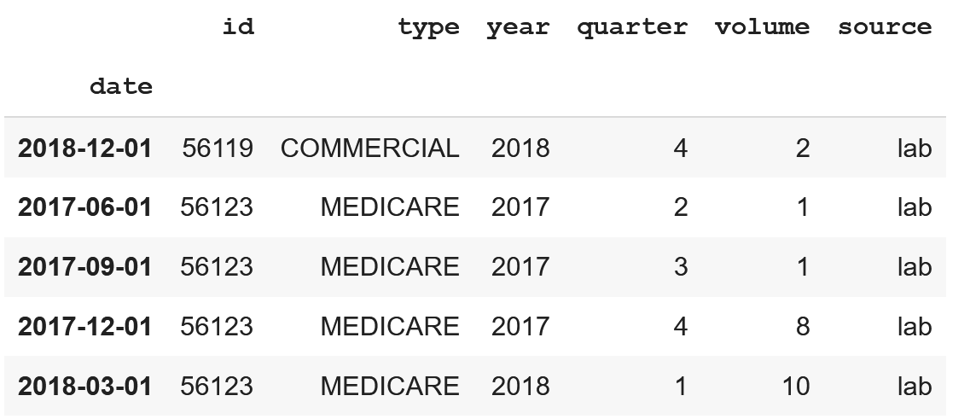
ETL (Extract Transform Load)
View of data Lab data
View of data Physician data
Feature Engineering
The NA values were seen only in ID column
The % of missing values were as below
Lab: 0.108% → 20 rows
Physician: 0.01% → 35 rows
Combined year and quarter column to a single Quarter start date column
Transformed column date to Index
Created a new Column “source” to represent the source of data either Lab or Physician
Combined Lab and Physician data to a single data frame
Identified total number of quarters, min date and max date

Slide 6
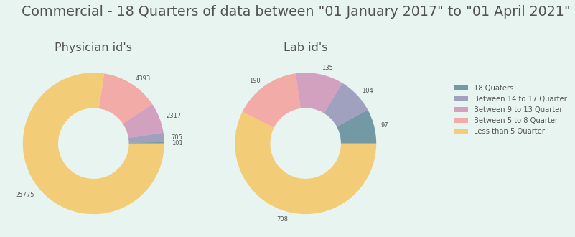
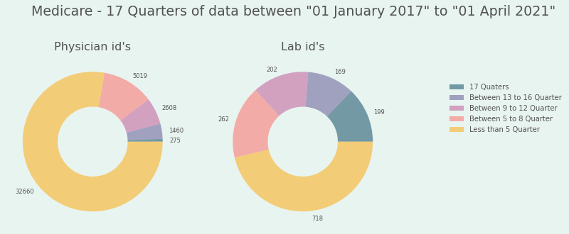
ETL (Quick look into the Data)
Lab / Physician
56119
Medicare
Commercial
56123
Source
ID of the referring physician
OR
ID of the lab
Insurance Type
Medicare
56126
Commercial
1003011339
Medicare
Commercial
Data for all years and Quarters
Data for all years and Quarters
2018Q1 & 2019Q4
Date and Quarter for which Volumes are available
2017Q2
2018Q4
2021Q2
…..
…..
…..

Slide 7
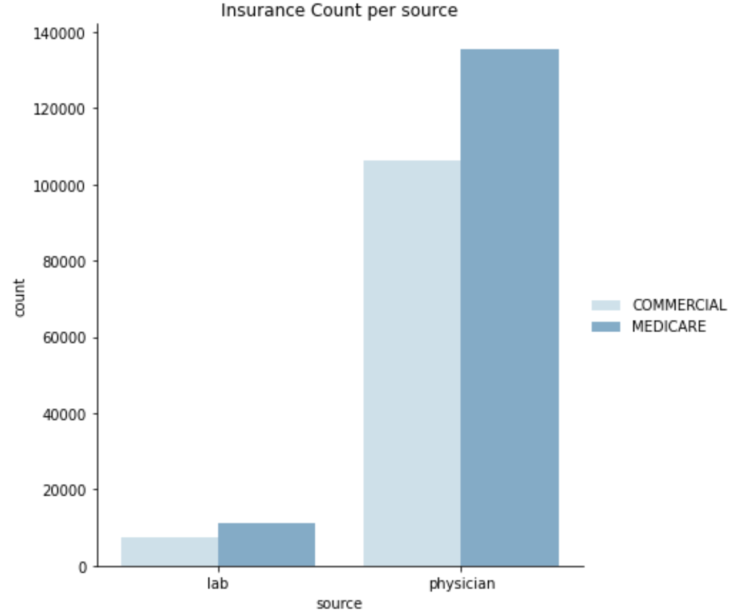
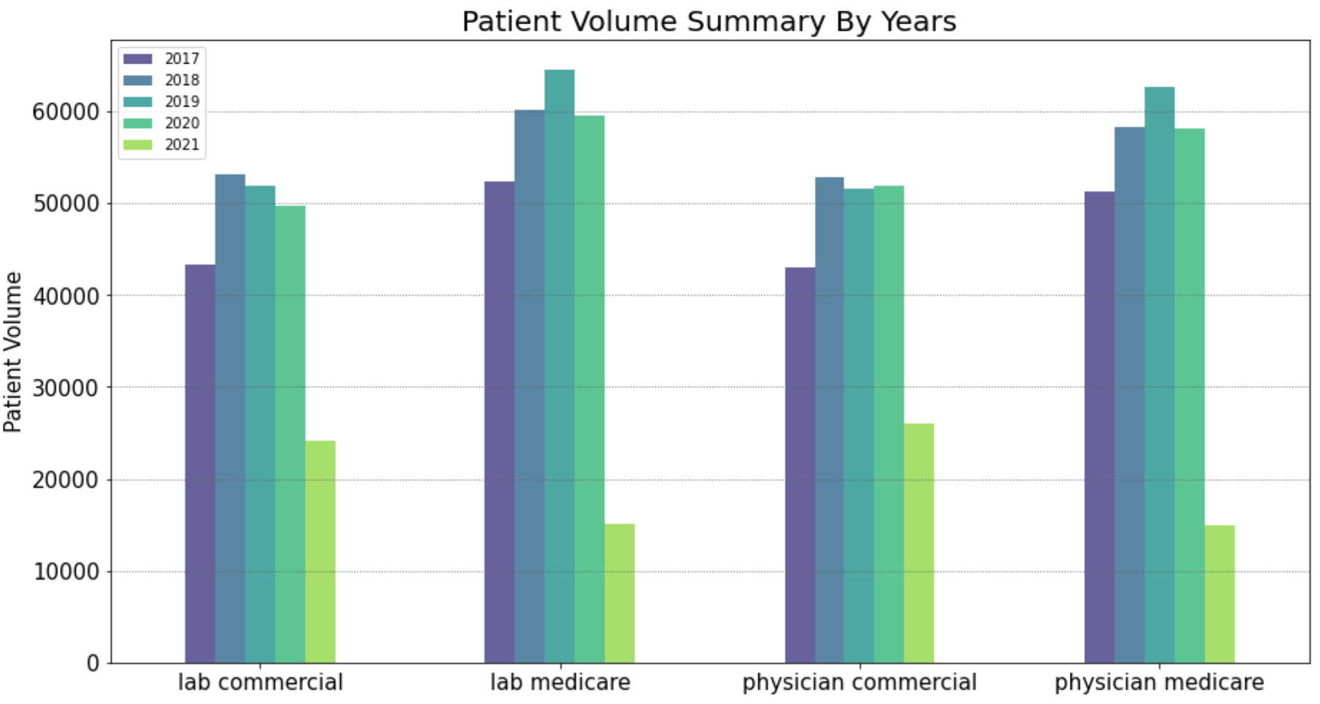
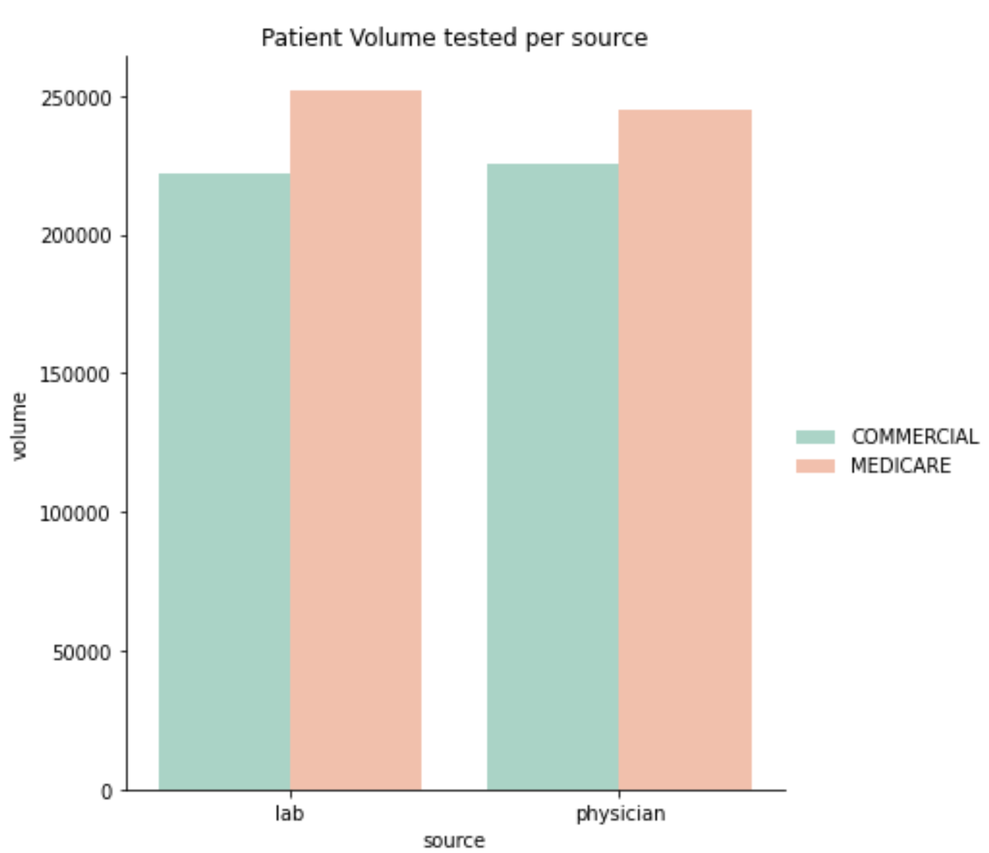
Exploratory Data Analysis
Total Id’s | Lab Id’s | Physician Id’s
54860 | 2076 | 52784

Slide 8
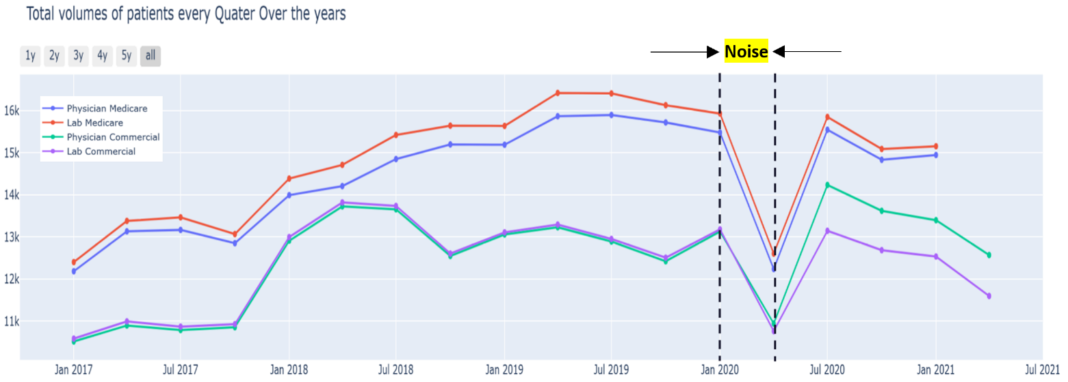
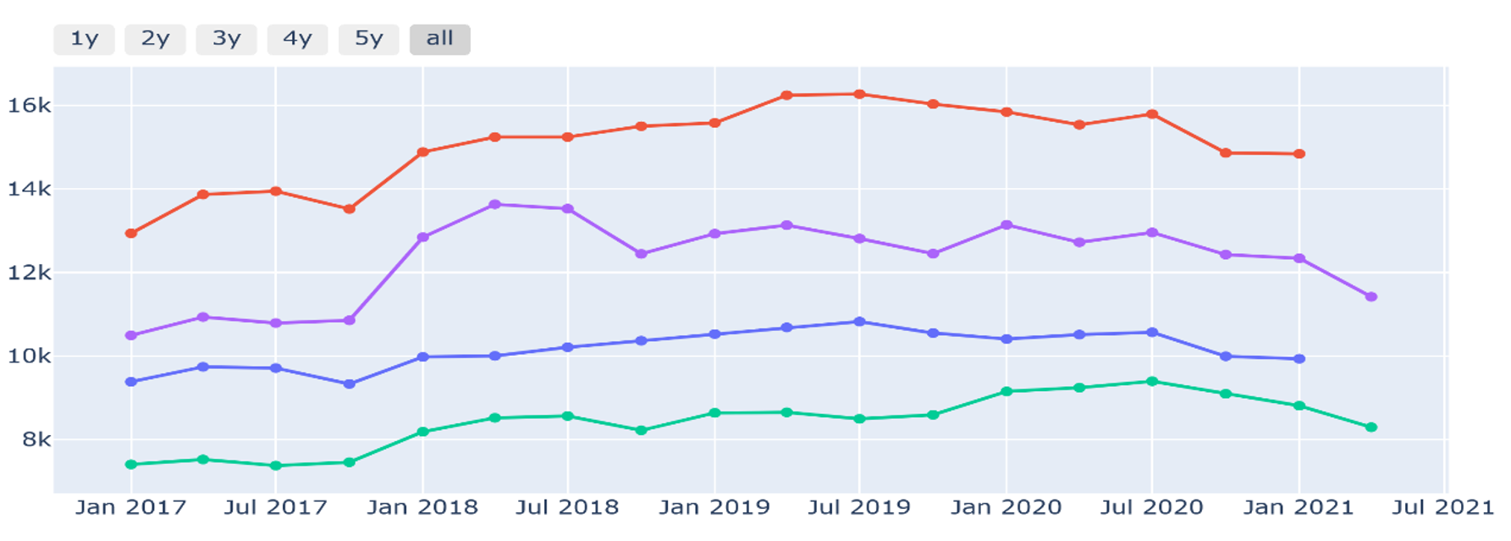
Imputation.…
Lab/Physician ID
No Missing volume
<=50% Missing Volume
>50% Missing Volume
Noise Imputation:
Remove COVID Phase Noise
Missing Value Imputation: Update Volume for missing quarters
Noise Imputation:
Remove COVID Phase Noise
No Imputation, Time series is ignored
Updated Time Series
Updated Time Series
Total Patient Volumes for Actual data
Total Patient Volumes after Data cleaning and Imputation

Slide 9
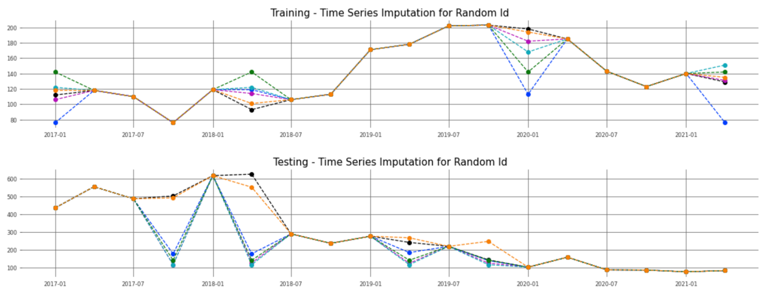
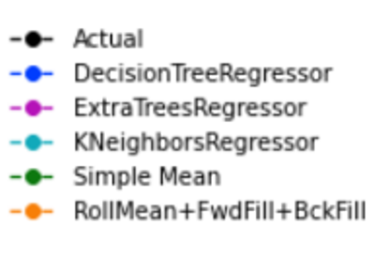
Exploratory Data Analysis Cont.…
Imputation techniques and there MSE
 | Training |  |  |  | Testing
 | Lab Commercial | Lab Medicare | Physician Commercial | Physician Medicare | Lab Commercial | Lab Medicare | Physician Commercial | Physician Medicare
DecisionTreeRegressor | 30.811193 | 4.81664 | 2.339278 | 1.89943 | 517.337584 | 103.53 | 3.764601 | 3.41823
ExtraTreesRegressor | 22.455965 | 3.97097 | 2.063349 | 1.51593 | 509.853697 | 103.42 | 3.587014 | 3.03832
KNeighborsRegressor | 28.390172 | 3.69579 | 1.880701 | 1.52109 | 519.169326 | 103.513 | 3.825596 | 2.81523
Simple Mean | 33.088294 | 4.47718 | 2.366041 | 1.74221 | 510.911718 | 103.399 | 3.224616 | 2.73611
RollMean+FwdFill+BckFill | 32.205187 | 4.23246 | 2.189622 | 1.5088 | 33.691987 | 19.9437 | 1.706198 | 1.52303
Actual vs Imputed values for a time series

Slide 10
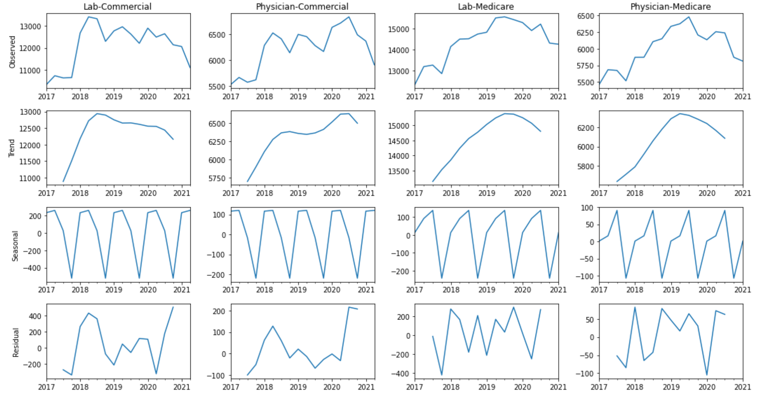
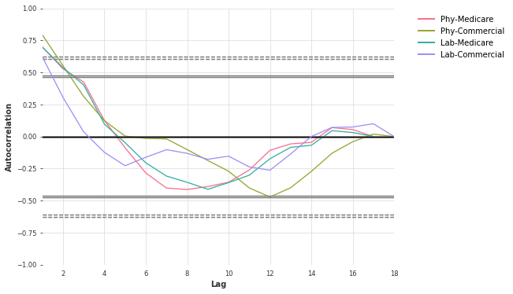
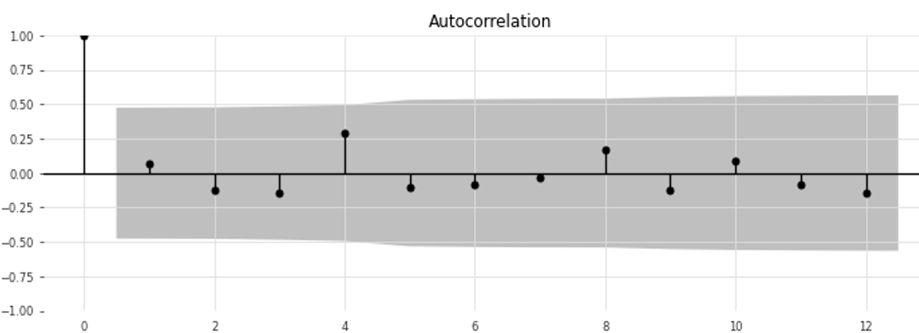
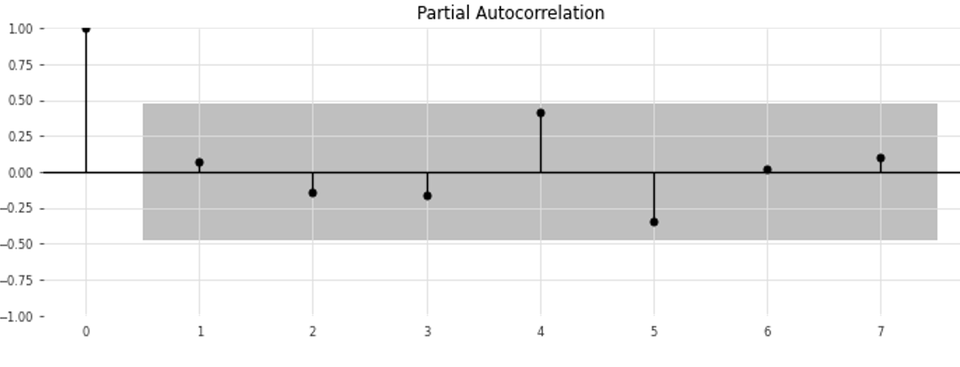
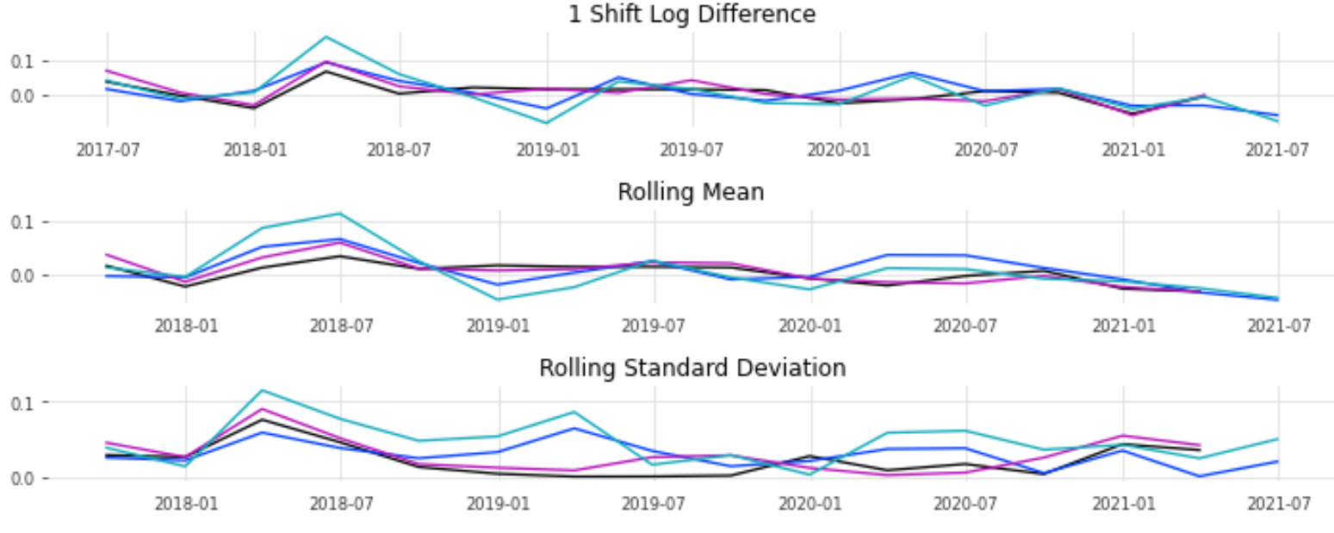
Exploratory Data Analysis Cont.…
1. DATA DECOMPOSITION
2. LAG AUTO CORRELATION
3. CONVERTING TO STATIONARY
4. ACF & PACF PLOTS

Slide 11
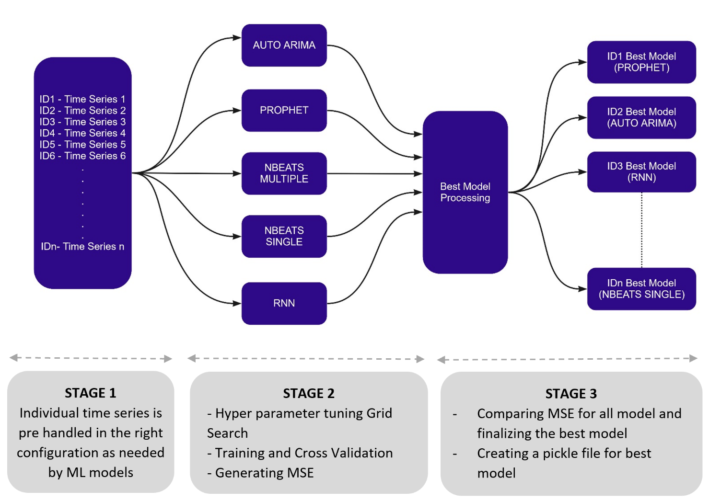
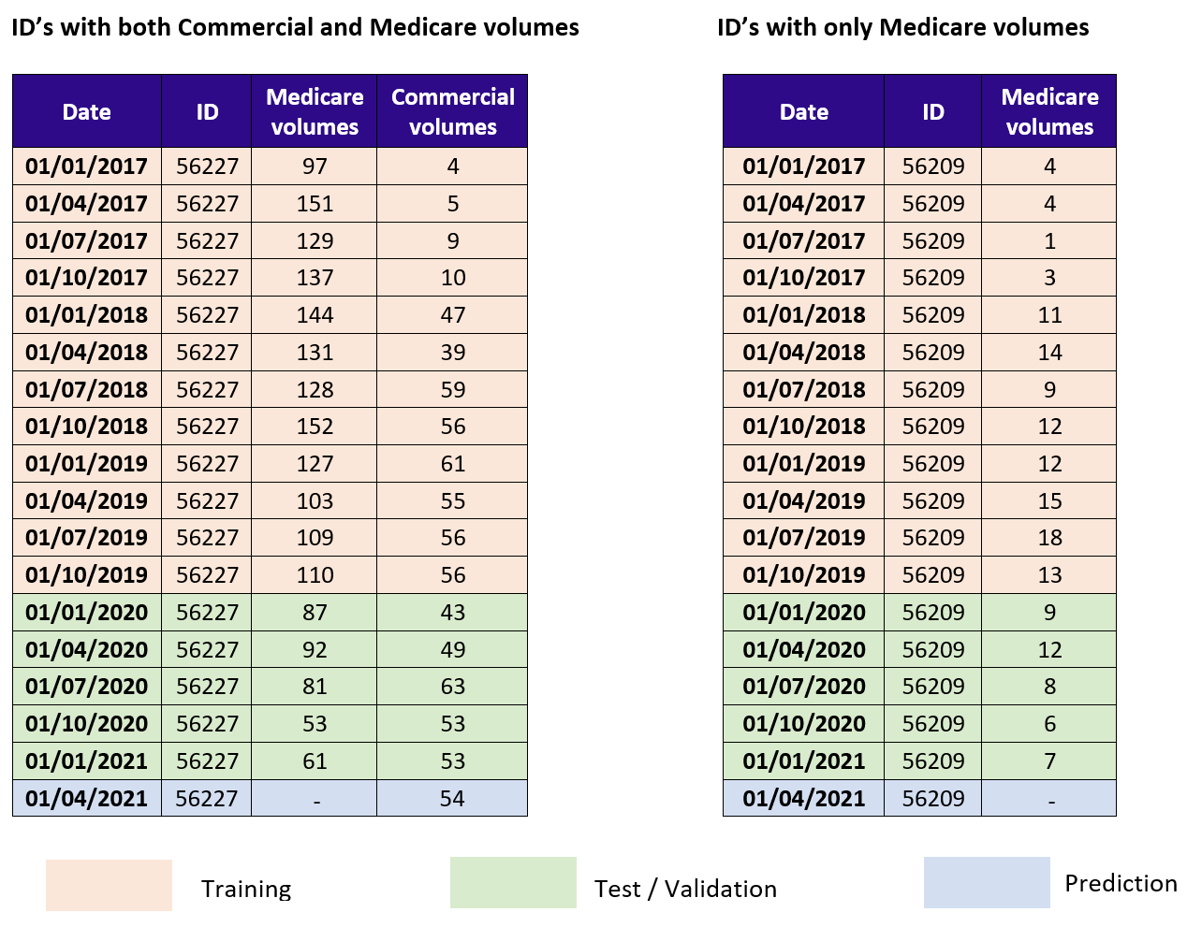
Train-Test Split and ML Architecture
 | Count | Prediction required?
Lab ID’s Medicare + Commercial | 213 | Yes
Lab ID’s Medicare | 357 | Yes
Lab ID’s Commercial | 123 | No
Physician ID’s Medicare + Commercial | 2128 | Yes
Physician ID’s Medicare | 2215 | Yes
Physician ID’s Commercial | 995 | No
Total | 6031

Slide 12
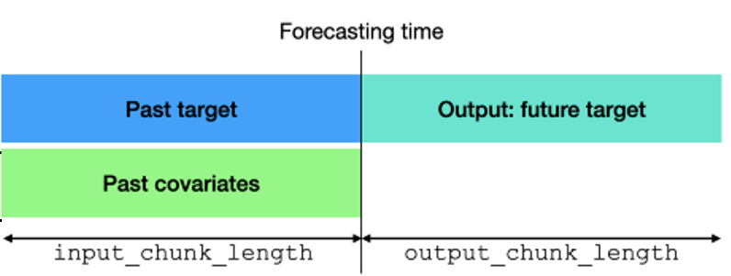
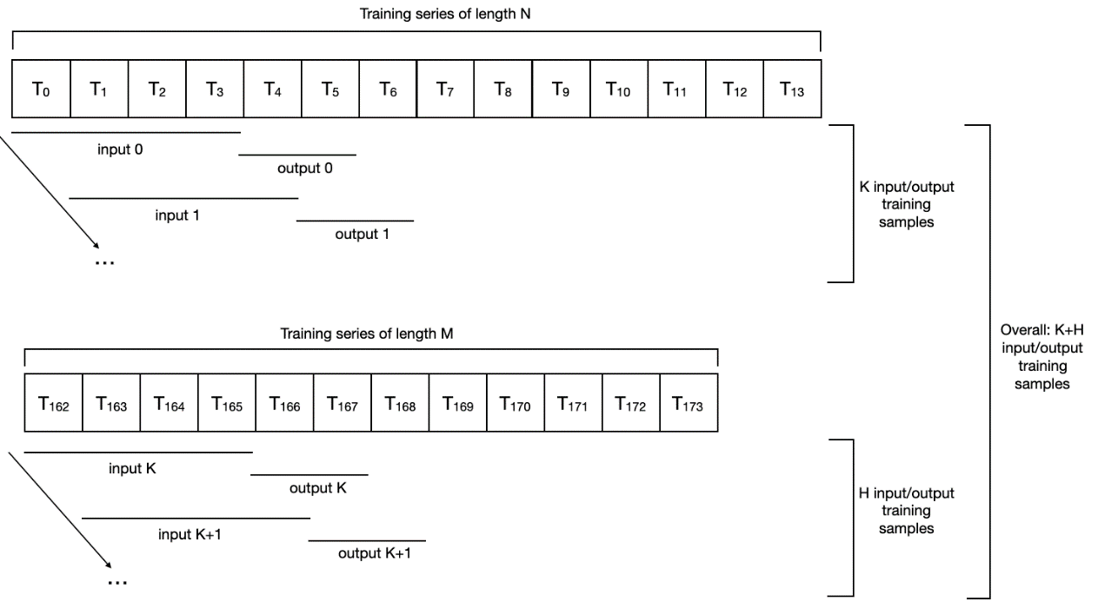
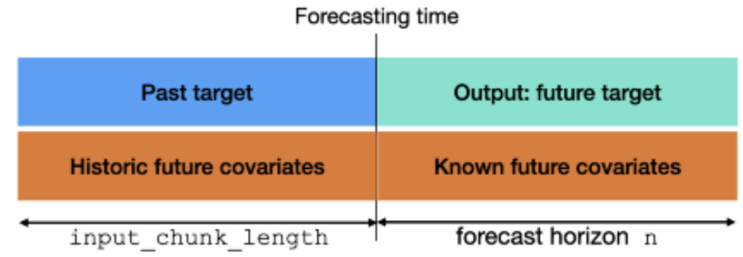
Machine Learning and Deep Learning Models
Model 1 → Auto ARIMA: Model 2 → Prophet: Model 3 → Nbeats Multiple:
Model 4 → Nbeats Single :
Model 5 → RNN (LSTM /GRU):
Model for each ID
Single Model for all IDs
Model for each ID

Slide 13
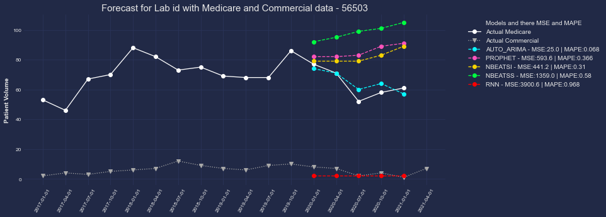
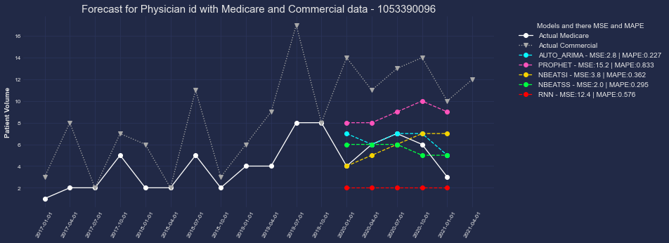
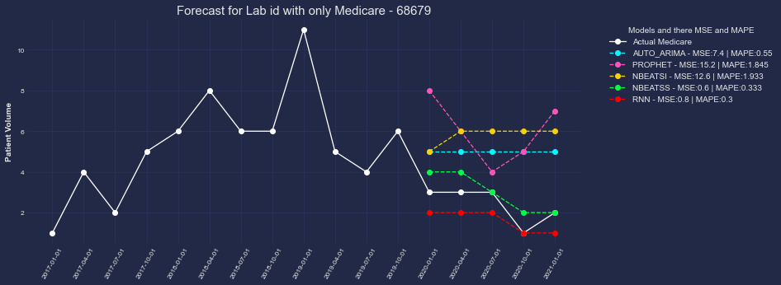
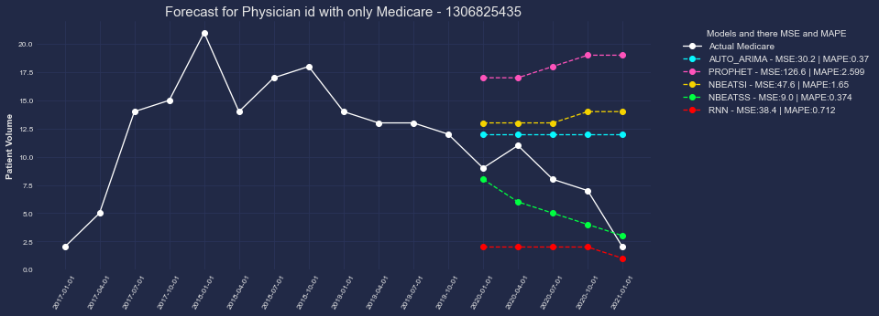
Train-Test Split and ML Architecture
AUTO_ARIMA → 1808 IDs | PROPHET → 835 IDs | RNN → 698 IDs | NBEATS Multiple →639 IDs | NBEATS Single → 933 IDs

Slide 14
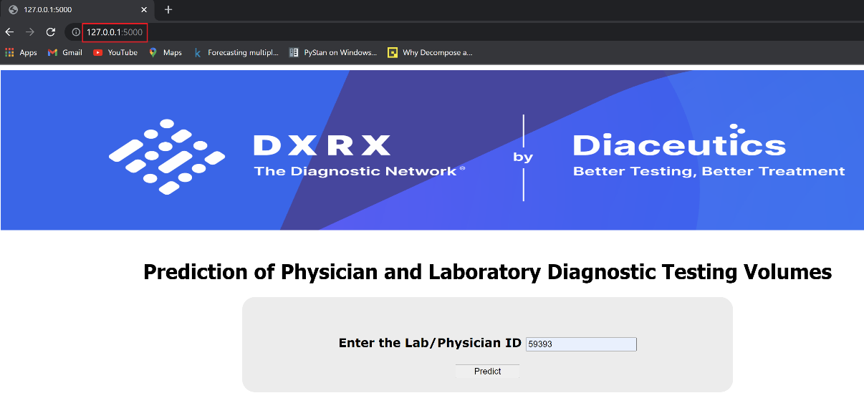
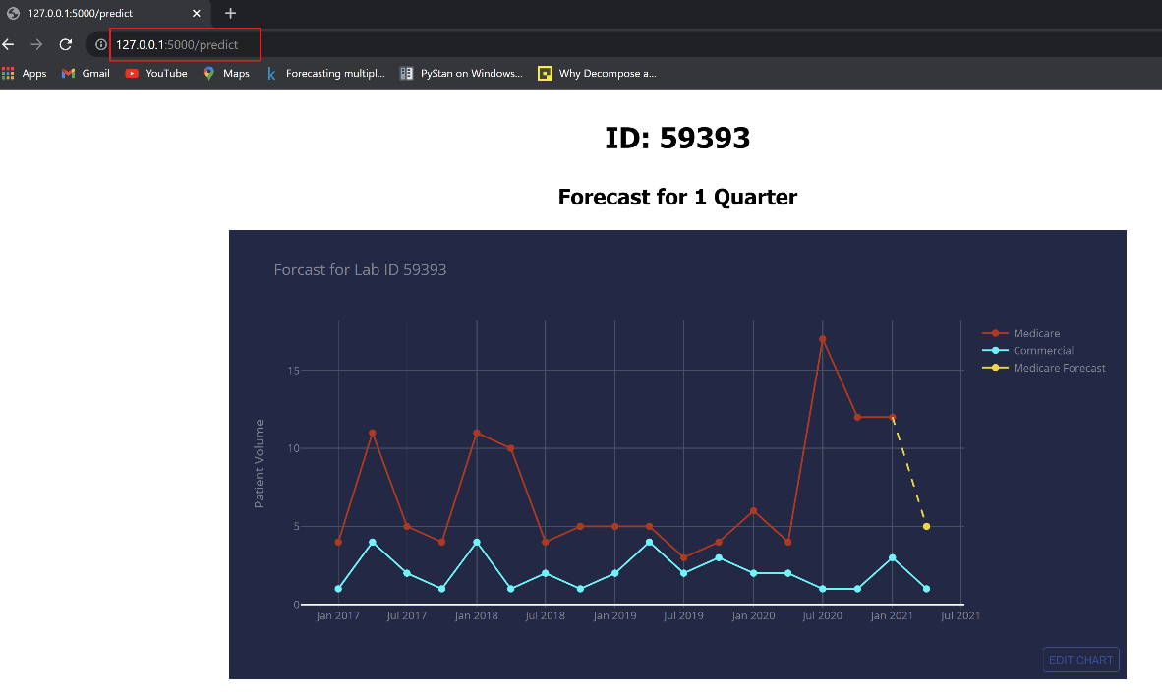
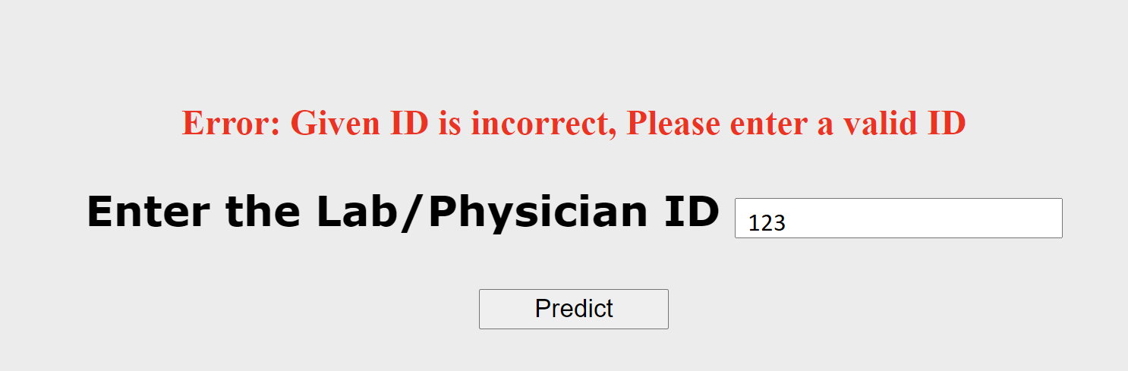
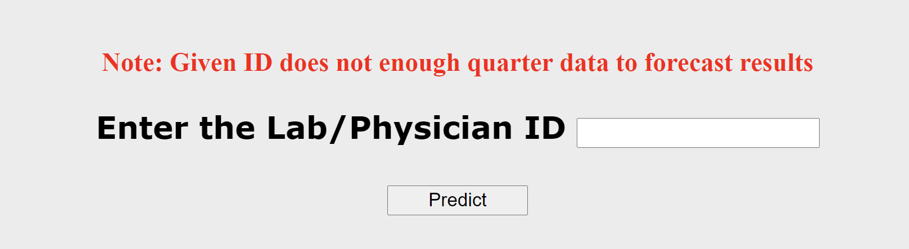
Web Application
Error for ID with less Data
Error for Invalid ID

Slide 15
References
Git Hub (Code)
https://github.com/AnjuBanu/Diaceutics_Medicare_Forecast.git
Others
Application of facebook's prophet algorithm for successful sales forecasting based on real-world data (2020) University of Sarajevo, Bosnia and Herzegovina https://arxiv.org/ftp/arxiv/papers/2005/2005.07575.pdf
N-beats: neural basis expansion analysis for interpretable time series forecasting (2020) Element AI https://arxiv.org/pdf/1905.10437.pdf
Fundamentals of Recurrent Neural Network (RNN) and Long Short-Term Memory (LSTM) Network (2020) https://arxiv.org/pdf/1808.03314v9.pdf
Distributed and parallel time series feature extraction for industrial big data applications (2017) University of Freiburg, Freiburg, Germany https://arxiv.org/pdf/1610.07717v3.pdf
Deep Learning For Time Series Classification (2020) https://arxiv.org/pdf/2010.00567v1.pdf
Forecasting: Principles and Practice” by Rob J. Hyndman and George Athanasopoulos https://otexts.com/fpp2/arima-r.html
“Time Series Analysis” by James Douglas Hamilton
Time Series Made Easy in Python https://github.com/unit8co/darts
Darts Nbeats Documentation https://unit8co.github.io/darts/examples/08-NBEATS-examples.html
Pmdarima https://pypi.org/project/pmdarima/
Time Series Forecasting Methods in Python (Cheat Sheet) https://machinelearningmastery.com/time-series-forecasting-methods-in-python-cheat-sheet/?unapproved=627419&moderation-
Prophet – Forecasting at scale by Facebook https://facebook.github.io/prophet/
Hierarchical Time Series Forecast for Apparel Industry — Doppler Effect https://medium.com/sfu-cspmp/doppler-effect-hierarchical-time-series-forecast-for-apparel-industry-45a55bb23be6
Flash Web application Framework https://palletsprojects.com/p/flask/
Forecasting multiple time-series using Prophet in parallel https://medium.com/spikelab/forecasting-multiples-time-series-using-prophet-in-parallel-2515abd1a245

Slide 16

THANK
YOU

